Slide 1

GA Capstone Project -
Sentiment Analysis using VADER
and Visualization using Power BI
in a business scenario
by Ferdinand Garcia
DSI 8
Aug. 2019

Slide 2
Introduction
Name : Ferdinand Garcia
Class : Data Science Immersive Program (DSI8)
Capstone Project :
Use Natural Language Programming (NLP) using Valence Aware Dictionary and sEntiment Reasoner (VADER) to determine overall sentiment of Customer comments
Use Python to input data to Microsoft Power BI
Use Microsoft Power BI visualization to highlight business insights

Slide 3
Business Challenge
To determine the overall sentiment based on provided customer feedback
To develop visualization to highlight the effect of the resulting sentiment to the overall business.
By Customer Demographics
By Product Hierarchy
Identify the potential audience to benefit from the data

Slide 4
Approach to solving the Challenge
Downloaded from
www.Kaggle.com
in .csv format
Use PYTHON
SCRIPT to load
dataset
MATPLOTLIB
Visualization
Data set with Feedback data
PYTHON Script
Dataset with VADER score
MS Power BI
Sentiment
Analysis
Visualization
Load PYTHON Modules
Load Dataset (pandas.read_csv)
Data Cleanup
Remove HTML tags (BeautifulSoup.get_text())
Remove non-letters (Regex.sub())
Split to words (nltk.word_tokenize())
Words to base form (nltk.WordNetLemmatizer())
Filter stopwords (nltk.stopwords())
Derive VADER score
Show correlation between VADER score and RATING
Classify VADER score to VG,G,N,B
Plot WordCloud to show prominent words in the comments
Demographics
Analysis
Visualization
Product
Analysis
Visualization
*nltk = Natural Language Toolkit
Fig. 1 Recommended Solution Architecture/ Data Flow

Slide 5
Capstone Solution
Acquire a dataset that contains customer feedback
Source data:
“Women’s Clothing E-commerce Review” dataset from Kaggle website
Contains 10 columns x 23,885 rows of reviews
Columns:
Clothing ID
Reviewer’s Age
Review Title
Review Text
Rating
Recommended IND:
Positive Feedback Count
Product Division Name
Product Department Name
Product Class Name

Slide 6
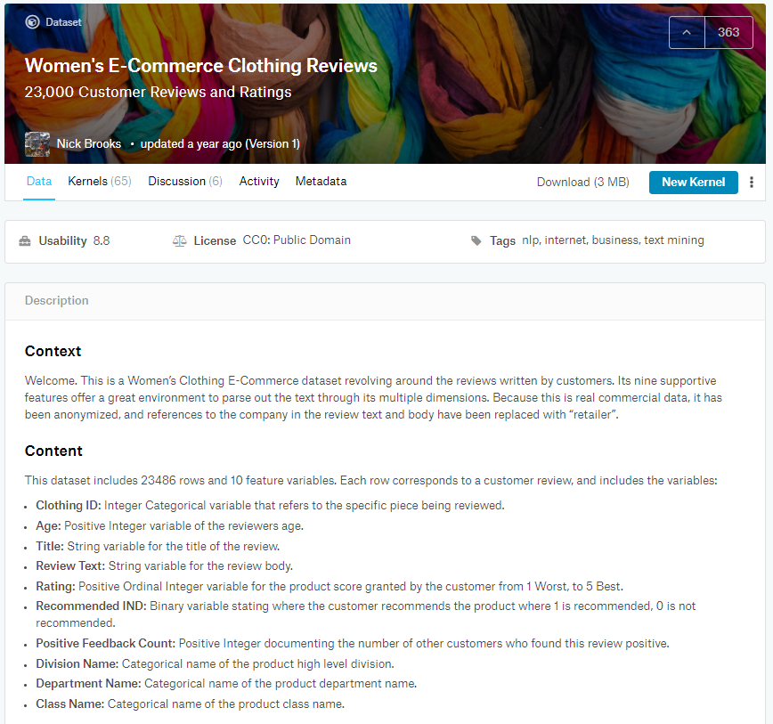
Fig. 2 Dataset description from
www.Kaggle.com

Slide 7
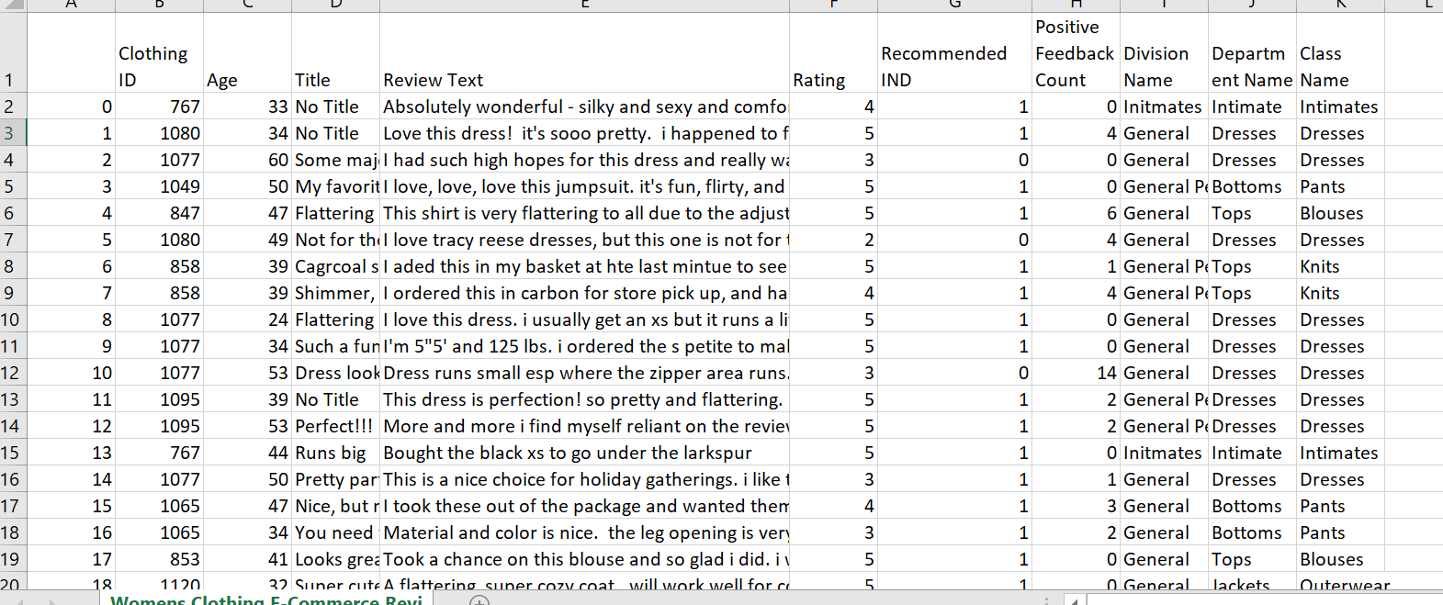
Fig. 3 Screen print of the “Women’s Clothing E-commerce Review” dataset from Kaggle

Slide 8
Capstone Solution
Observation/Insight
Why choose the specific Kaggle dataset?
It contains 10 columns x 23,885 rows of reviews; sufficient data to calculate VADER scores
It provides user demographics (age)
It provides product information relevant to the review

Slide 9
Capstone Solution
Develop PYTHON script
Jupyter notebook used to develop the PYTHON script.
Ensure that the script was successfully executed with the agreed steps

Slide 10
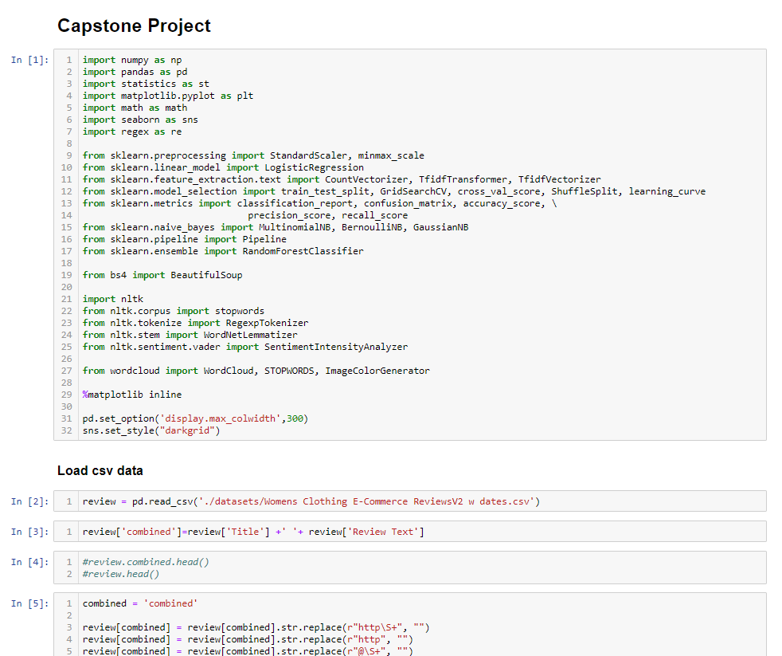
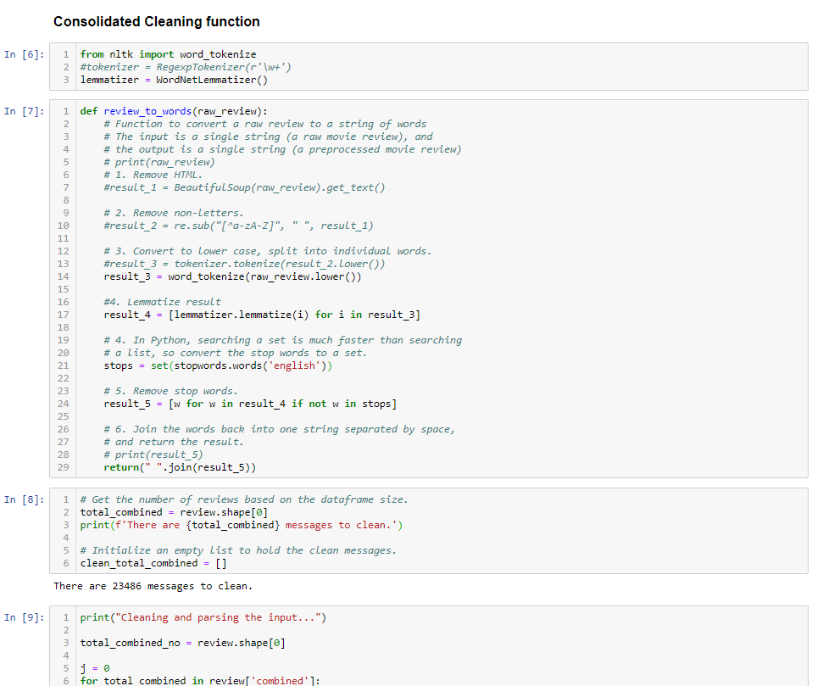
Fig. 4 Screen print of the PYTHON script showing use of different PYTHON libraries, Data Loading and Cleaning steps

Slide 11
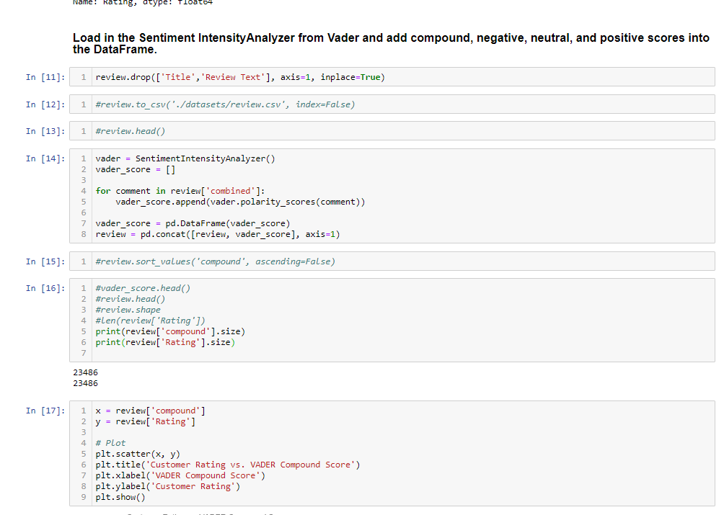
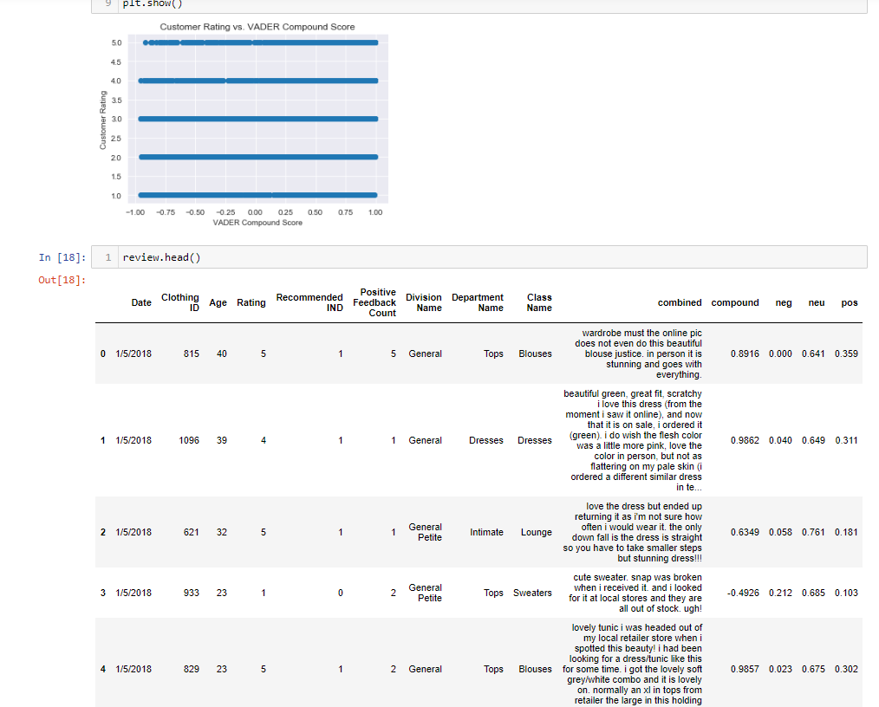
Fig. 6 Screen print of the PYTHON script showing running of VADER, generating Scatter plot and showing VADER scores

Slide 12
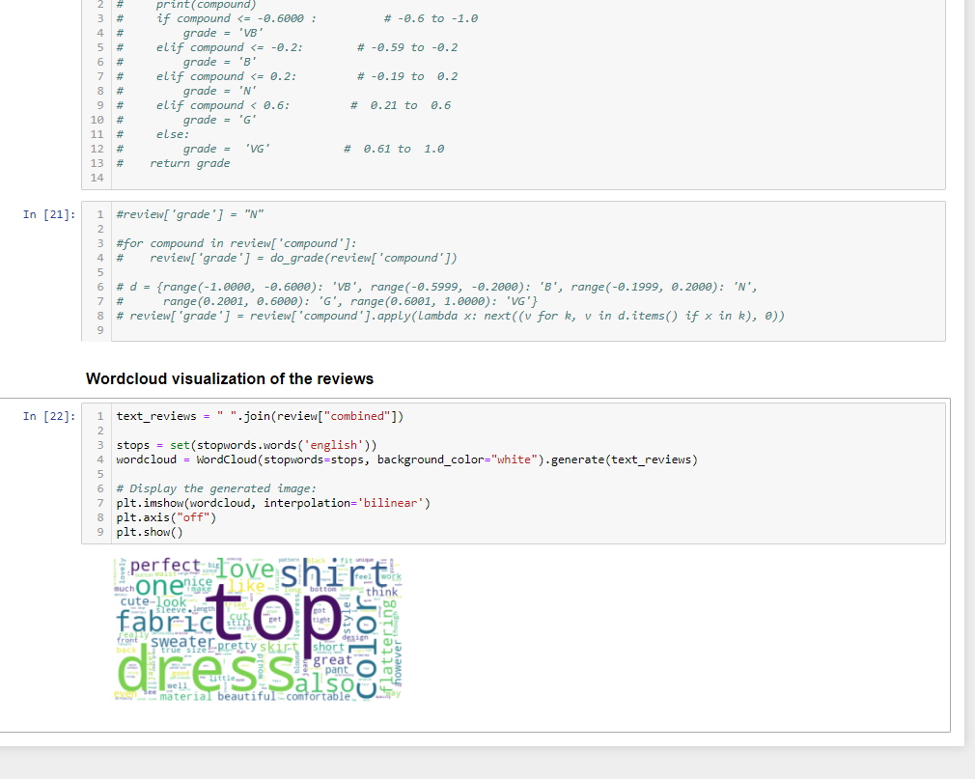
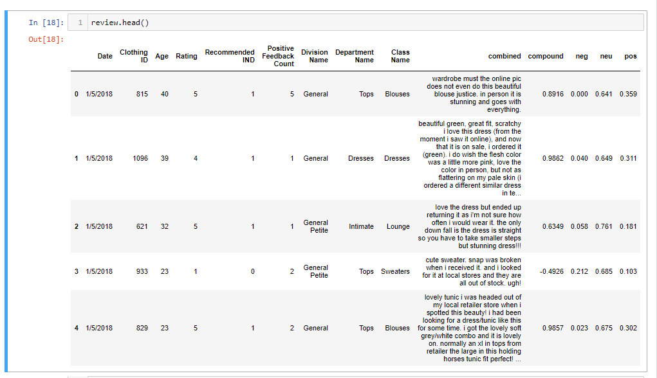
Fig. 7 Screen print of the PYTHON script showing generating WordCloud chart and showing VADER scores

Slide 13
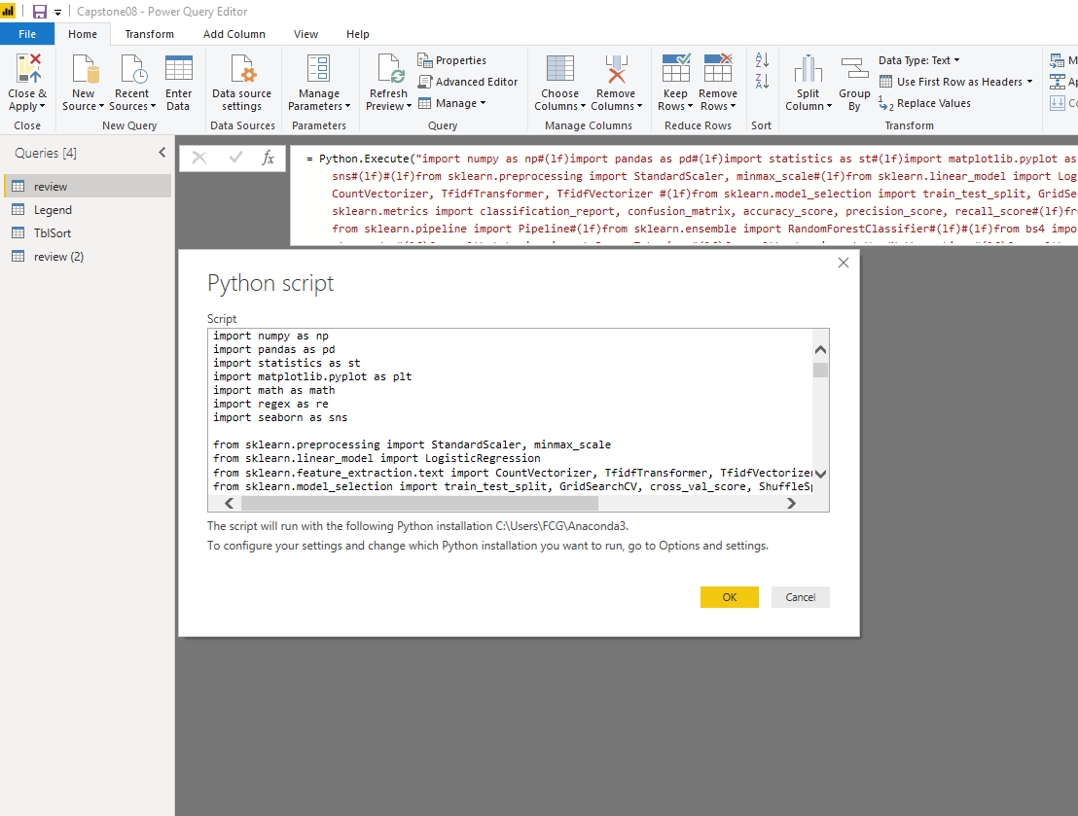
Capstone Solution
Use PYTHON script to load the updated dataset into MS Power BI
Fig. 8 PYTHON script used as Data Source to MS Power BI as copied from the Jupyter notebook

Slide 14
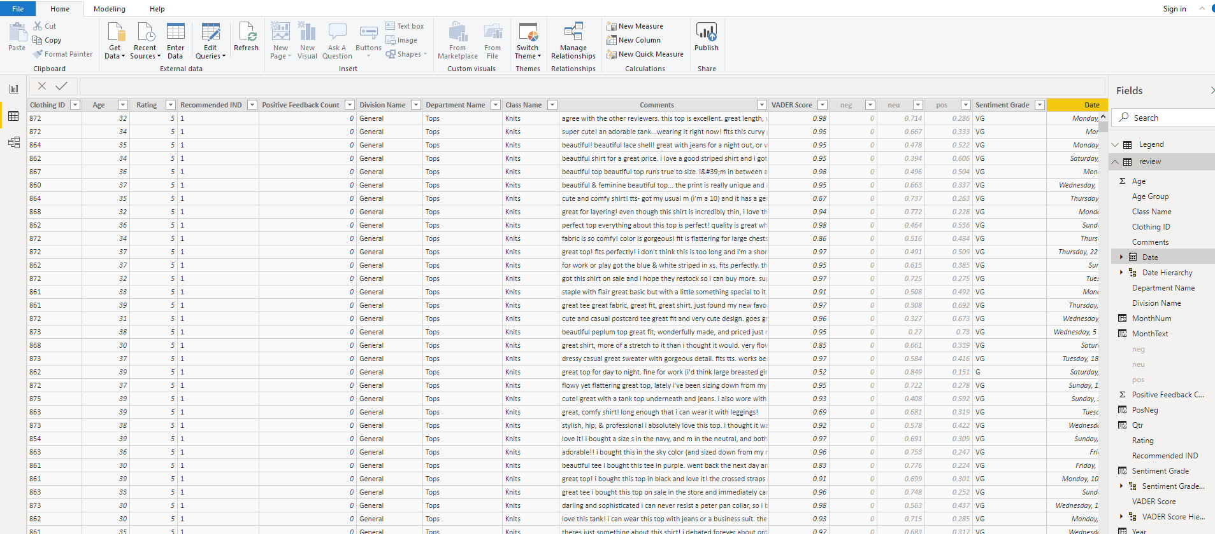
Fig. 6 data as generated and loaded in to Power BI

Slide 15
Capstone Solution
Observation/Insight
Doesn’t PYTHON have its own visualization features? Why choose MS Power BI to do visualization?
Yes, PYTHON has its own visualization features. This will be simulated later in POWER BI.
POWER BI provides an interactive experience where multiple charts can be updated in a synchronized manner. (ideal for business presentation)

Slide 16
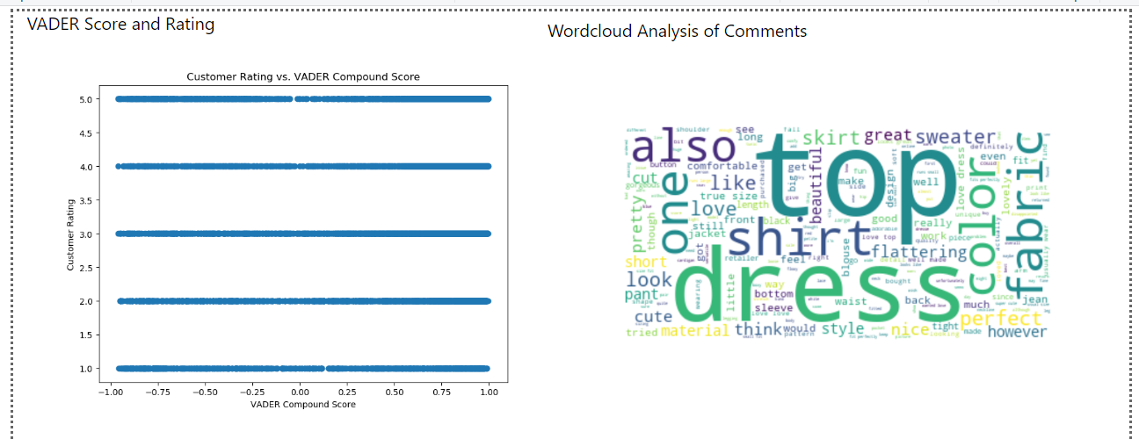
Capstone Solution
Highlight the visualization plus the corresponding business insights
MATPLOTLIB Visuals
- Purpose: to show that Python visualization can also work in this environment

Slide 17
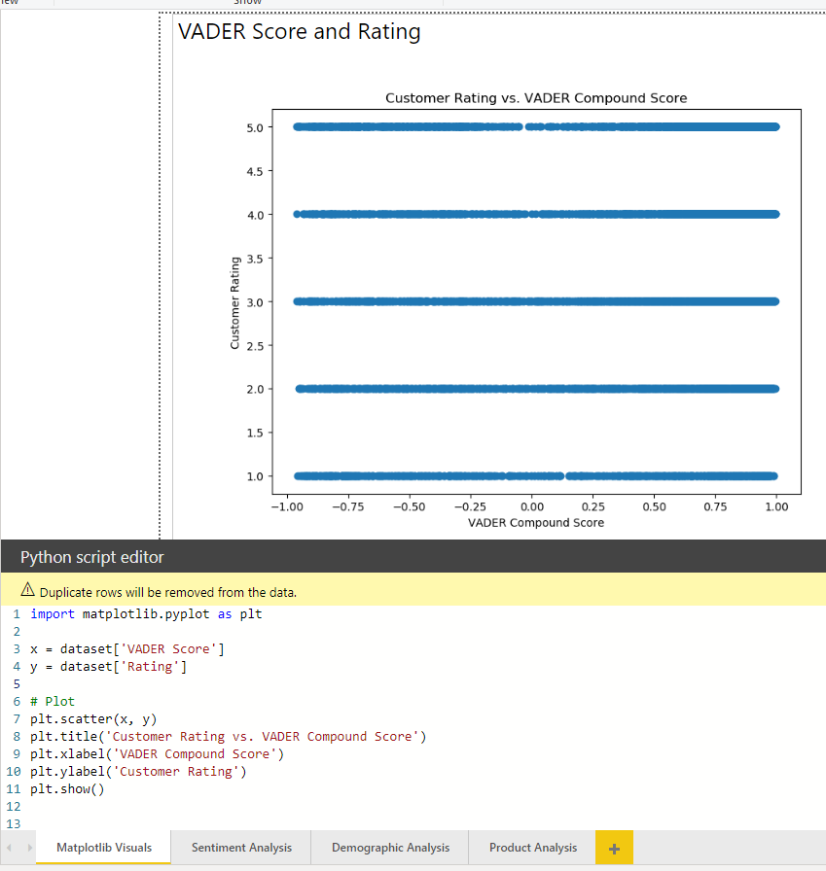
Capstone Solution
Highlight the visualization plus the corresponding business insights
MATPLOTLIB Visuals
- Purpose: to show that Python visualization can also work in this environment
Scatterplot chart : VADER Compound Score vs. Customer Rating
Shows NO co-relation
Customer Rating was written independent of overall sentiment of comment

Slide 18
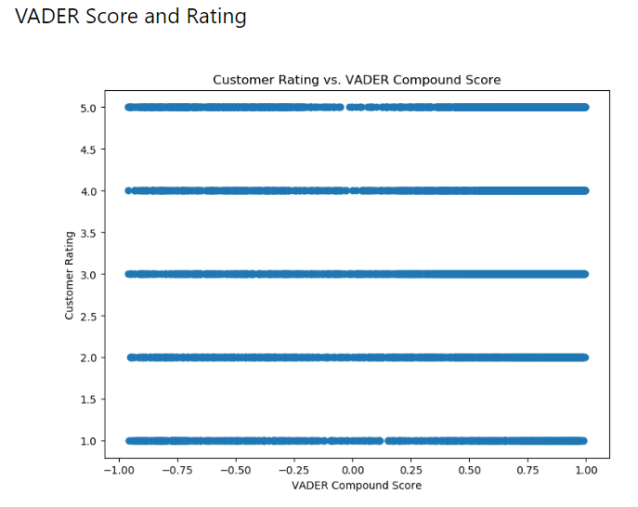
Capstone Solution
Observation/Insight
VADER Compound Score has more relevance to overall sentiment of comment
Moving forward, VADER Compound Score will be used to rate overall sentiment of comment

Slide 19
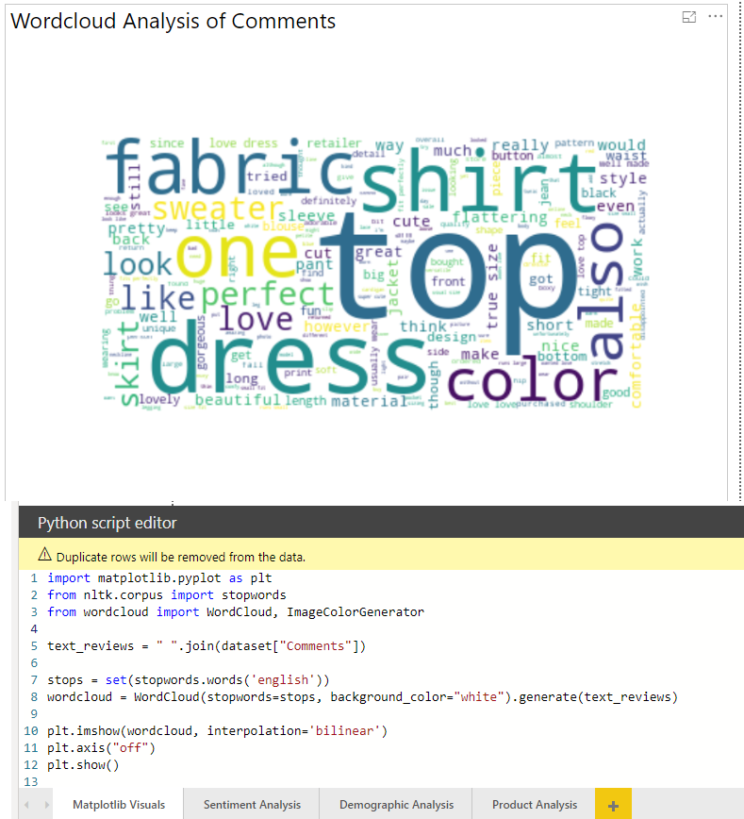
Capstone Solution
WordCloud Analysis of Comments
Generated using the following PYTHON libraries:
NLTK.Corpus.Stopwords
Wordcloud.WordCloud and ImageColorGenerator
Shows the prominent keywords across the comments:
Top
Dress
Shirt, Fabric, Color

Slide 20
Capstone Solution
Observation/Insight
It is important for the company to take note of the prominent words in the WordCloud as these represents the issues mostly talked about by the customers (whether in positive or negative sentiment)
In the report, the words “Top”, “Dress”, “Shirt”, “Fabric”, “Color” are the words often referred to in the comments. It will be worth investigating what these words refer to in order to further understand the underlying customer sentiment ( Example: new product?, frequent complaint, need for improvement?)
In the future, the list of STOPWORDS can be updated with words deemed to be non-essential.

Slide 21
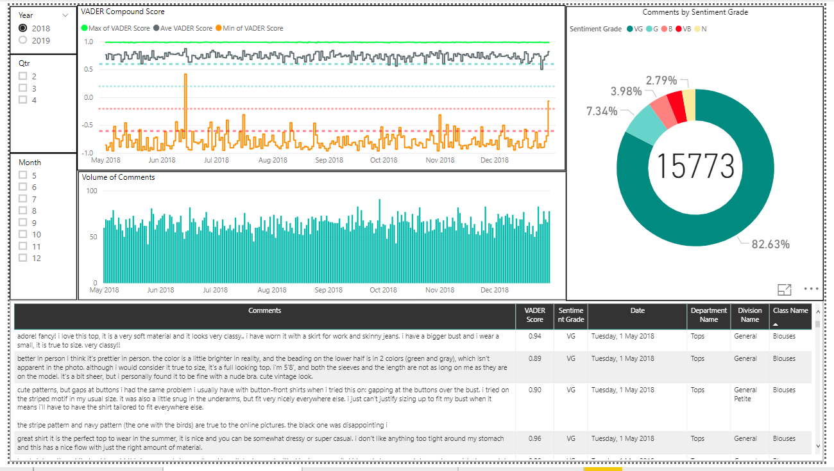
Capstone Solution
Sentiment Analysis Visuals
- Purpose: to uncover the underlying sentiment in the customer comments

Slide 22
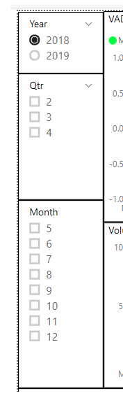
Capstone Solution
Sentiment Analysis Visuals
- Purpose: to uncover the underlying sentiment in the customer comments
Data Slicer Panels – ability to filter visualization based on time (Year, Qtr, Month) across the page

Slide 23
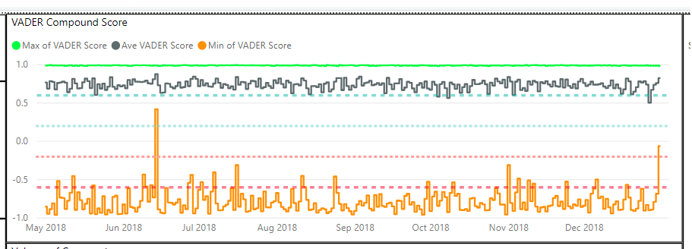
Capstone Solution
Shows cutoff line between Sentiment Grade:
“VB” – VADER Compound Score within -1.00 to – 0.60
“B” – VADER Compound Score within -0.59 to – 0. 20
“N” – VADER Compound Score within -0.19 to – 0. 20
“G” – VADER Compound Score within 0.21 to 0.60
“VG” – VADER Compound Score within 0.61 to – 1.00
Sentiment Analysis Visuals
VADER Compound Score
highlights MAX, MEAN and MIN scores per day

Slide 24
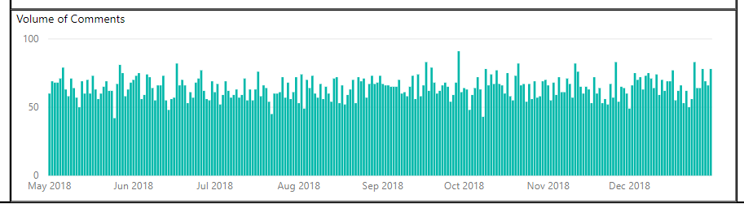
Capstone Solution
Comments per Day
shows volume of comments per day, any seasonality patterns, provide YOY comparison
Synchronized to support other charts

Slide 25
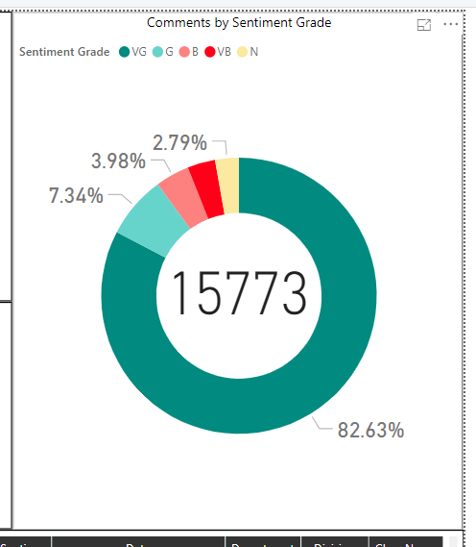
Capstone Solution
Doughnut Chart on Comments by Sentiment Grade
Provides total and breakdown by Sentiment Grade
Synchronized to support other charts

Slide 26
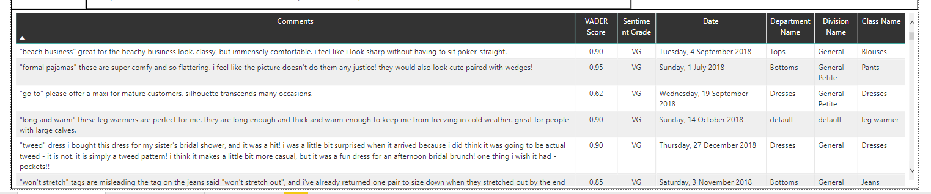
Capstone Solution
Record List/Table
Displays records as filtered in other charts
Synchronized to support other charts

Slide 27
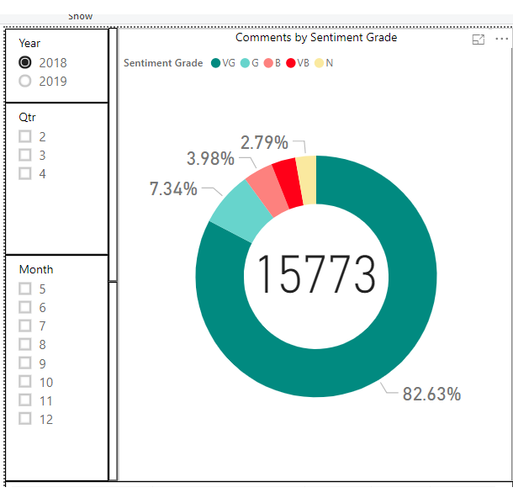
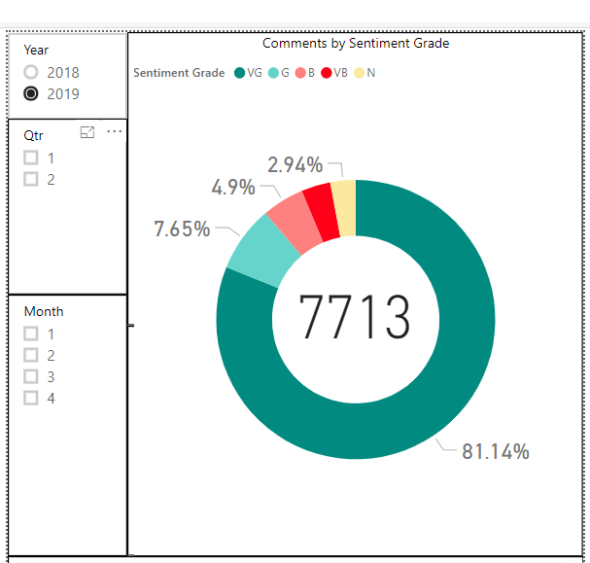
Capstone Solution
Observation/Insight
2018 has double the data of 2019; it is assumed that 2019 operations are still ongoing.
The dataset is imbalanced towards “VG” Sentiment Grade
“VG” Sentiment Grade accounts for 80% on all years
“VG” + “G” Sentiment Grade accounts for approx. 90% on all years

Slide 28
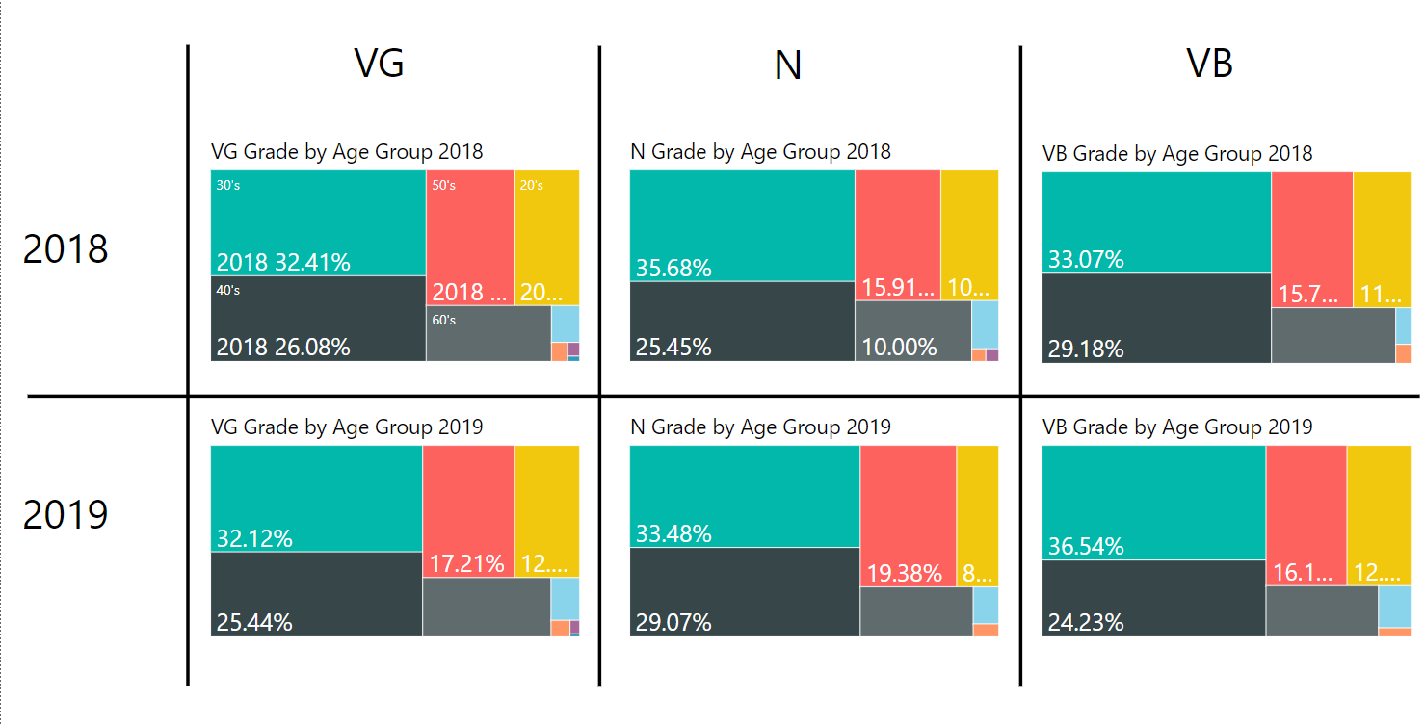
Capstone Solution
Demographic Analysis Visuals
- Purpose: to see the relationship between demographics and customer sentiment
TreeMap Chart on Sentiment Grade across years and Age Group

Slide 29
Capstone Solution
Observation/Insight
30’s and 40’s age groups have been predominant across all Sentiment Category and years
Teens age group have been participating less than 1% across all Sentiment Category and years
The company needs to reflect on their overall strategy if they:
Want to serve a niche market (30 and 40’s age groups) OR
Expand their products and re-strategize marketing efforts to attract more customers of other age group (especially Teens and 20’s)
Questions to ask: Age Group interest? , Products?, Accessibility? (Twitter vs. Facebook)

Slide 30
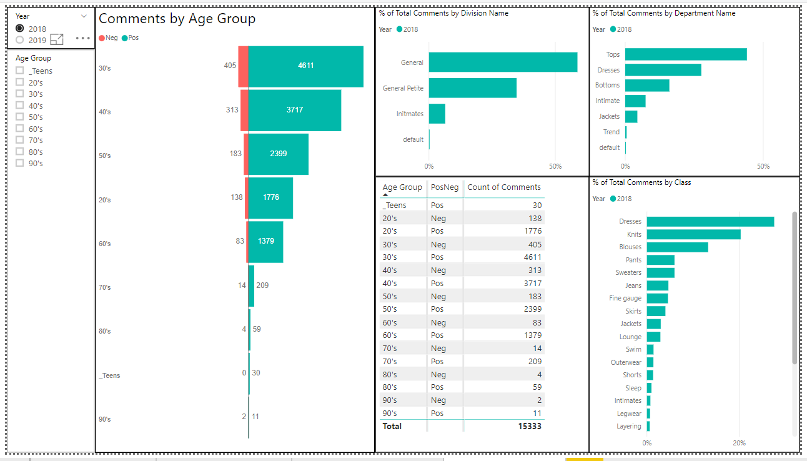
Capstone Solution
Product Analysis Visualization
- Purpose: to see the relationship between products, demographics and customer sentiment

Slide 31
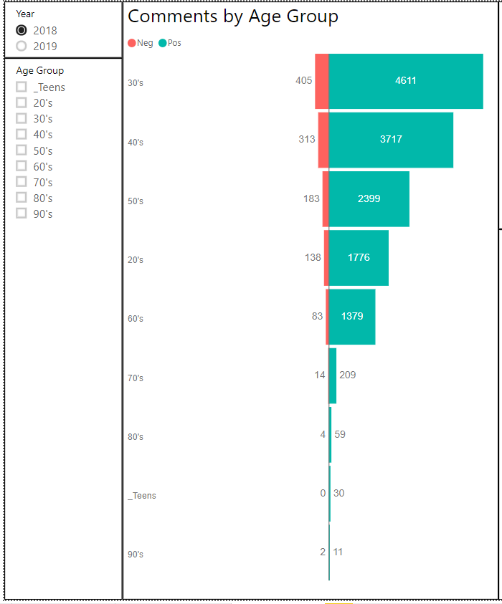
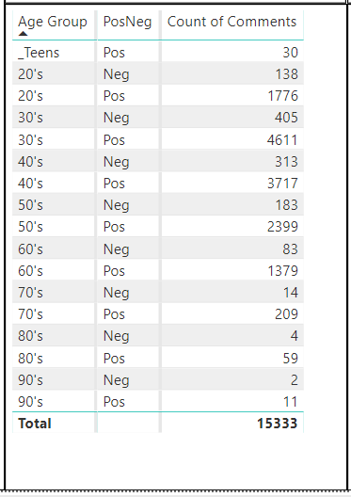
Capstone Solution
Product Analysis Visualization
- Purpose: to see the relationship between products, demographics and customer sentiment
Data Slicer Panels – ability to filter visualization based on Year and Age Group
Tornado Chart on Comments by Age Group
Neg Category = “VB” + “B” Sentiment Class
Pos Category = “VG” + “G” Sentiment Class
Neutral Sentiment Class is filtered out
Record Summary Table

Slide 32
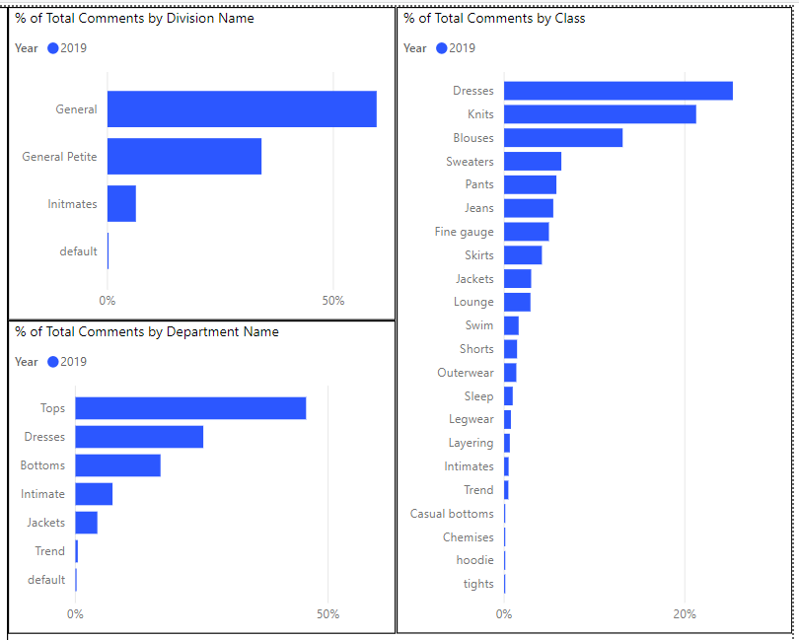
Capstone Solution
Product Analysis Visualization
Purpose:
To provide a quick escalation method to responsible company division/departments
The bar charts below highlights the existing product hierarchy :
Bar Chart by Division Name
Bar Chart by Department Name
Bar Chart by (Product) Class

Slide 33
Capstone Solution
Observation/Insight
Sentiment can be linked to specific product class, but product hierarchy is loosely defined on the Division level.
It is recommended to re-organize product hierarchy to systematically identify company entities responsible for the product-sentiment relationship.

Slide 34
Capstone Solution
Conclusion
Sentiment Analysis offers benefits for business:
Better decision making
Enhance customer experience
Optimize Marketing strategy
Gain competitive advantage

Slide 35
Capstone Solution
Conclusion
Companies should start to prepare its current infrastructure to leverage on Sentiment Analysis :
Start to develop and maintain a robust feedback mechanism from direct customers
Ensure feedback channels is accessible to intended users
Collected feedback should result into actionable information (business and technical issues)
Ensure that relevant users are involved in the feedback review process
Be kept abreast of new developments in the Sentiment Analysis domain

Slide 36
Thank you!

